Slide 1
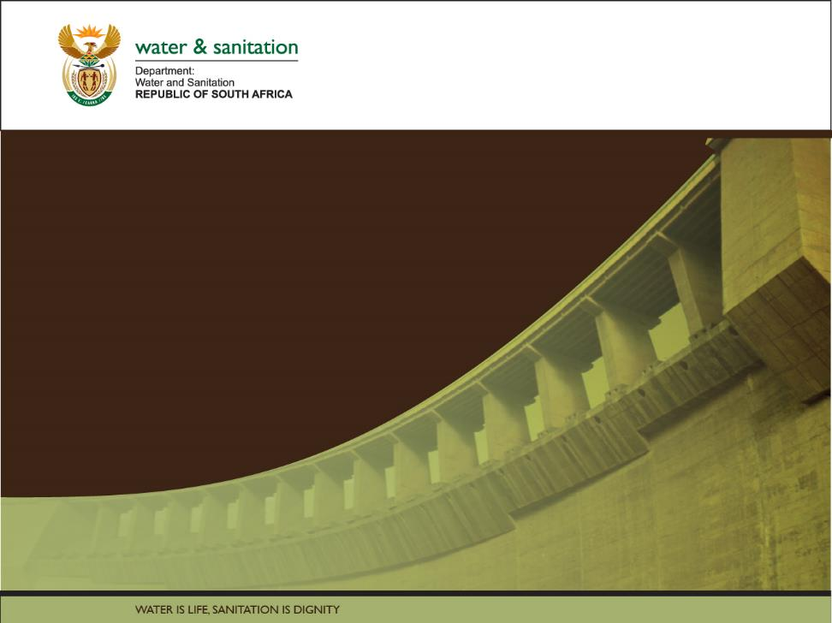

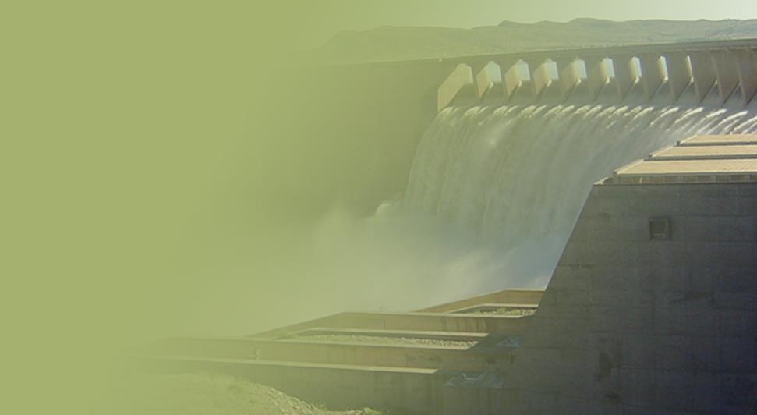
The Determination of Water Resources Classes and Resource Quality Objectives for the water resources in in the Breede-Gouritz WMA
Public Meeting
23rd – 24th July 2018
Robertson and George

Slide 2
Study Objectives
Co-ordinate implementation of the Water Resources Classification System (WRCS):
  Determine Water Resources Classes (WRCs)
  Determine Resource Quality Objectives (RQOs)
  Support Gazetting of Recommended Water Resources Classes and RQOs
  for the water resources in the Breede-Gouritz WMA:
  - Rivers - Estuaries - Groundwater
  - Dams - Wetlands

Slide 3
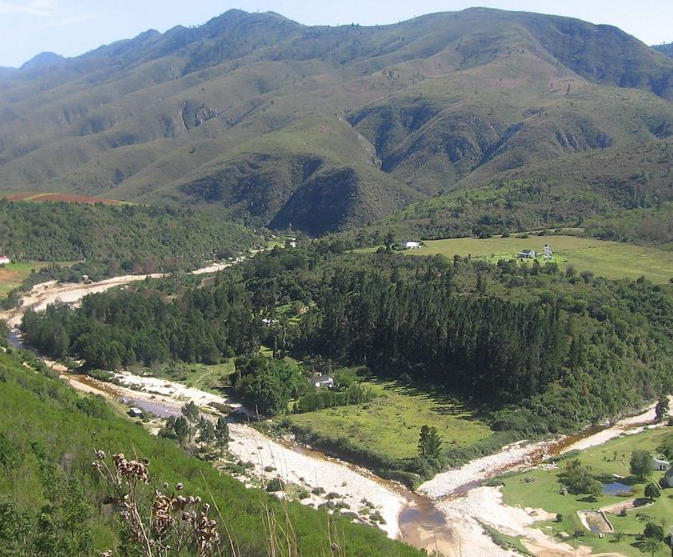

5.2 Overview of Study Processes followed

Slide 4
Previous public meetings held
  At the previous public meetings held in Nov 2016, an introduction to the study and an overview of progress on the following tasks was presented:
  Socio-economic status & activities
  Delineation of Resource Units and Integrated Units of Analysis (IUAs)
    Resource Units & Nodes for water resource types
  Status Quo

Slide 5
Main Study Tasks
Task 1: Inception Completed
  Inception Report
  Stakeholder Identification and Mapping Report
Task 2: Information gathering Completed
  Water Resources Information and Gap Analysis
Task 3: Determine Water Resource Classes
  Resource Units & IUA Delineation Report
  Status Quo Report
  Linking the Value & Condition of Water Resources
  Quantification of the EWR and changes in EGSAs
  Ecological Base Configuration Scenarios Report
  Report on Evaluation of Classification Scenarios
Task 4: Determine Resource Quality Objectives
  Resource Unit Prioritization Report
  Evaluation of Resource Units
  Outline of Resource Quality Objectives
  Monitoring Program to Support RQOs Implementation (July)
  Confidence Assessment of Resource Quality Objectives (July)
Task 5: Support Gazetting done by DWS to legalise
  Final Report and Gazette template (Dec)
Completed
In Progress
WE ARE HERE
In Progress

Slide 6
Resource Units (RUs) and Nodes
Task 3: Determine Water Resource Class
Scenario analysis process
Resource units (RUs) are grouped areas e.g. river basins, deemed similar in terms of various characteristics
Are used to transfer information between catchments
Groundwater
  Nodes are locations of interest (points) in a water resource (rivers, dams, wetlands, estuaries)
  Are sited using:
  Water infrastructure
  Aquatic ecosystem attributes
  Are used to allocate water for environment and development

Slide 7
Task 3: Determine Water Resource Class
Scenario analysis process
Scenarios are possible future states of the WMA
Evaluation is done for projected 2040 situation
High growth in urban & industrial water demand, with implementation of planned schemes
Urban & Industrial growth is met by augmentation
Notes:
Our study has estimated the economic cost of this substitution as being the additional cost of water supply. NB: This assumes that the water is supplied, rather than the EC being met through curtailing water licences, which we assume would have the biggest economic impact. We therefore assumed a principle of no reduction in the level of existing economic activities, determined that cost, but did not address who will pay.

Slide 8
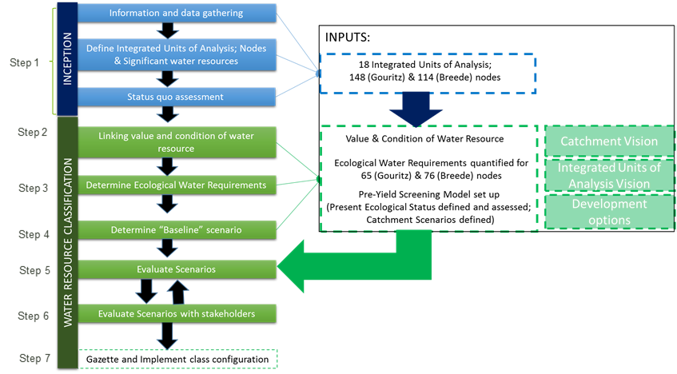
Task 3: Determine Water Resource Class
Data inputs for scenario assessment

Slide 9
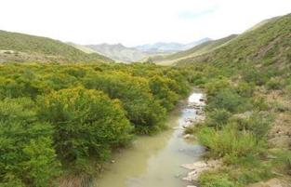
Task 3: Determine Water Resource Class
INPUT: Surface water hydrology
Estimated river flows by quaternary (or smaller area) for natural state & current situation
Using refined/corrected monthly WRSM 2012 hydrological model, further sub-divided to reflect river and estuary nodes
Taking meteorology, water allocations, water use, water infrastructure and water transfers into account
Generated different sets of flow sequences used for different water requirement scenarios

Slide 10
Task 3: Determine Water Resource Class
INPUT: Ecological Water Requirements
Provides supporting information for Scenario Evaluation, to assess impacts of changes in catchment configuration
Data on Ecological Water Requirements and changes in the non-water quality Ecosystem Goods Services and Attributes used to determine:
  flow requirements at individual nodes based on the recommended Ecological Category
  the impact of alternative development scenario on the ecological condition of individual nodes
  Associated impact in terms of changes in EGSAs will then be used to evaluate the impacts of alternative scenarios

Slide 11
Task 3: Determine Water Resource Class
Scenarios evaluated
6 Scenarios (possible future states) evaluated:
  Maximum abstraction within set limits (ESBC)
  Maintain present condition (PES)
  Recommended ecological condition (REC)
  Spatially-targeted mix
Also (for comparative purposes):
  What would happen without environmental constraints (No EC), and
  With climate change as well (No EC + CC)
Notes:
ESBC = Ecological sustainable base configuration “bottom line”
In addition to these four main scenarios a NoEC was considered which is a development focused, ecological conditions are not constrained and a climate change scenario.
Additional water supply costs that would need to be incurred in order to meet current and future water demands
For current situation this is in addition to existing water supply infrastructure and for future projections this was in addition to planned surface water infrastructure for the WMA.

Slide 12
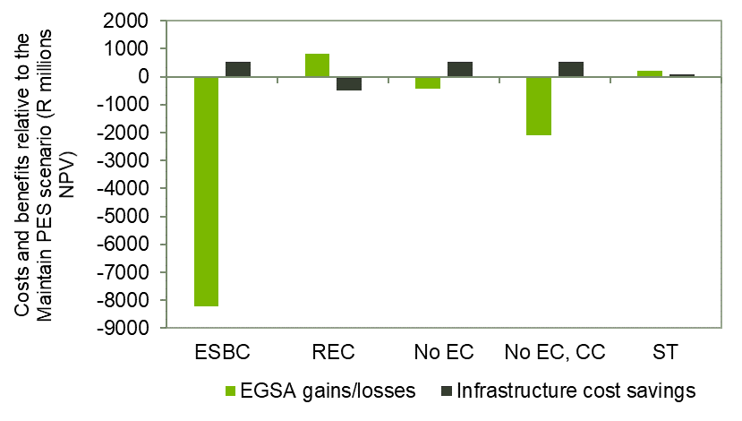
Scenario analysis economic outcome
Task 3: Determine Water Resource Class
Scenario outcome
Costs/benefits calculated relative to PES scenario
ESBC comes at very high cost to society
REC has highest net benefit
Spatially-targeted scenario avoids water losses
  Net benefit similar to REC
Maintaining PES = third best outcome
Notes:
Results indicate risks of welfare losses under ESBC scenario would be very high.
A scenario in which demands are met without any environmental constraints would also result in a net welfare loss, and this would be exacerbated under a climate change scenario.
In fact, it should be borne in mind that the results of any classification scenario are likely to be negatively affected by climate change. Maintaining PES leads to the second-best outcome, but the best outcome from an economic perspective appears to be the allocation of the ecological REC.
The spatially targeted scenario is not shown on here but lies between the REC and PES – in that while the change in ES value is slightly lower than REC the water supply costs are also lower and therefore the difference between the REC and the Spatially-targeted scenario is minor.

Slide 13
5.3 Proposed water resource classes

Slide 14
Task 3: Determine Water Resource Class
Spatially-targeted Scenario
Proposed scenario
Aims to balance protection of critical ecological areas with reduced costs of additional water supply infrastructure to meet shortfalls in terms of EWR requirements
Based on spatial considerations of priority objectives
Results in a blend of targeted ECs for all nodes ranging between REC and ESBC
The impacts of this scenario are tested against future water demands only
Notes:
ESBC = Ecological sustainable base configuration “bottom line”
In addition to these four main scenarios a NoEC was considered which is a development focused, ecological conditions are not constrained and a climate change scenario.
Additional water supply costs that would need to be incurred in order to meet current and future water demands
For current situation this is in addition to existing water supply infrastructure and for future projections this was in addition to planned surface water infrastructure for the WMA.

Slide 15
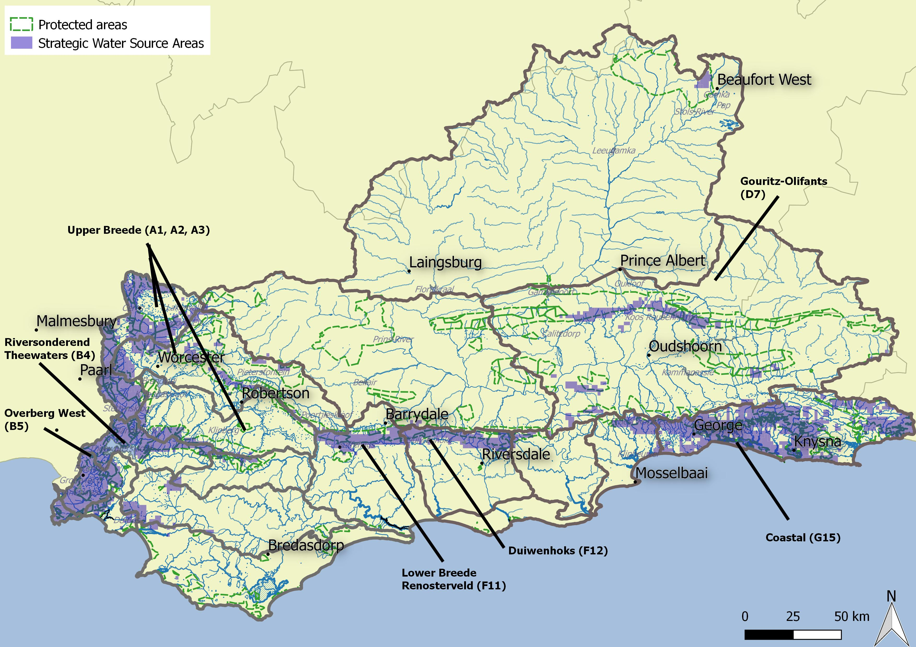
Ecological considerations

Slide 16
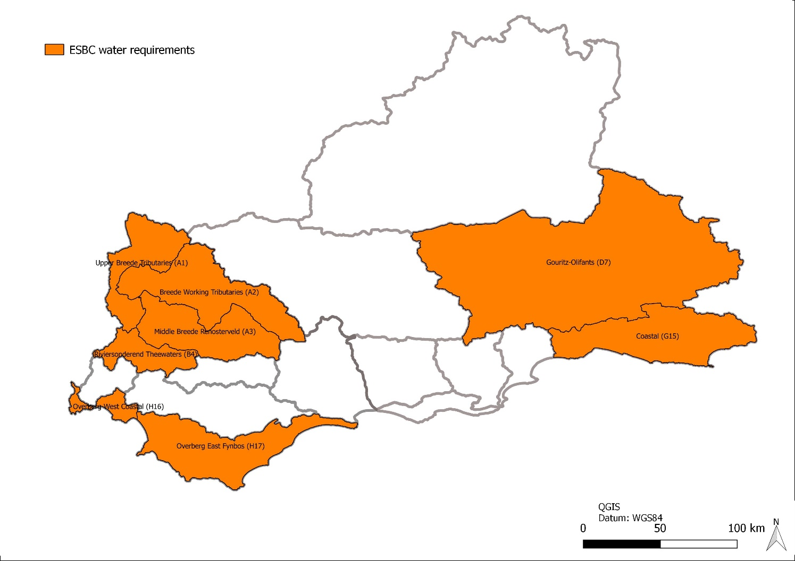
Development considerations
Beaufort West
Prince Albert
Worcester
Oudtshoorn
Riversdale
Knysna
Mosselbaai
Bredasdorp

Slide 17
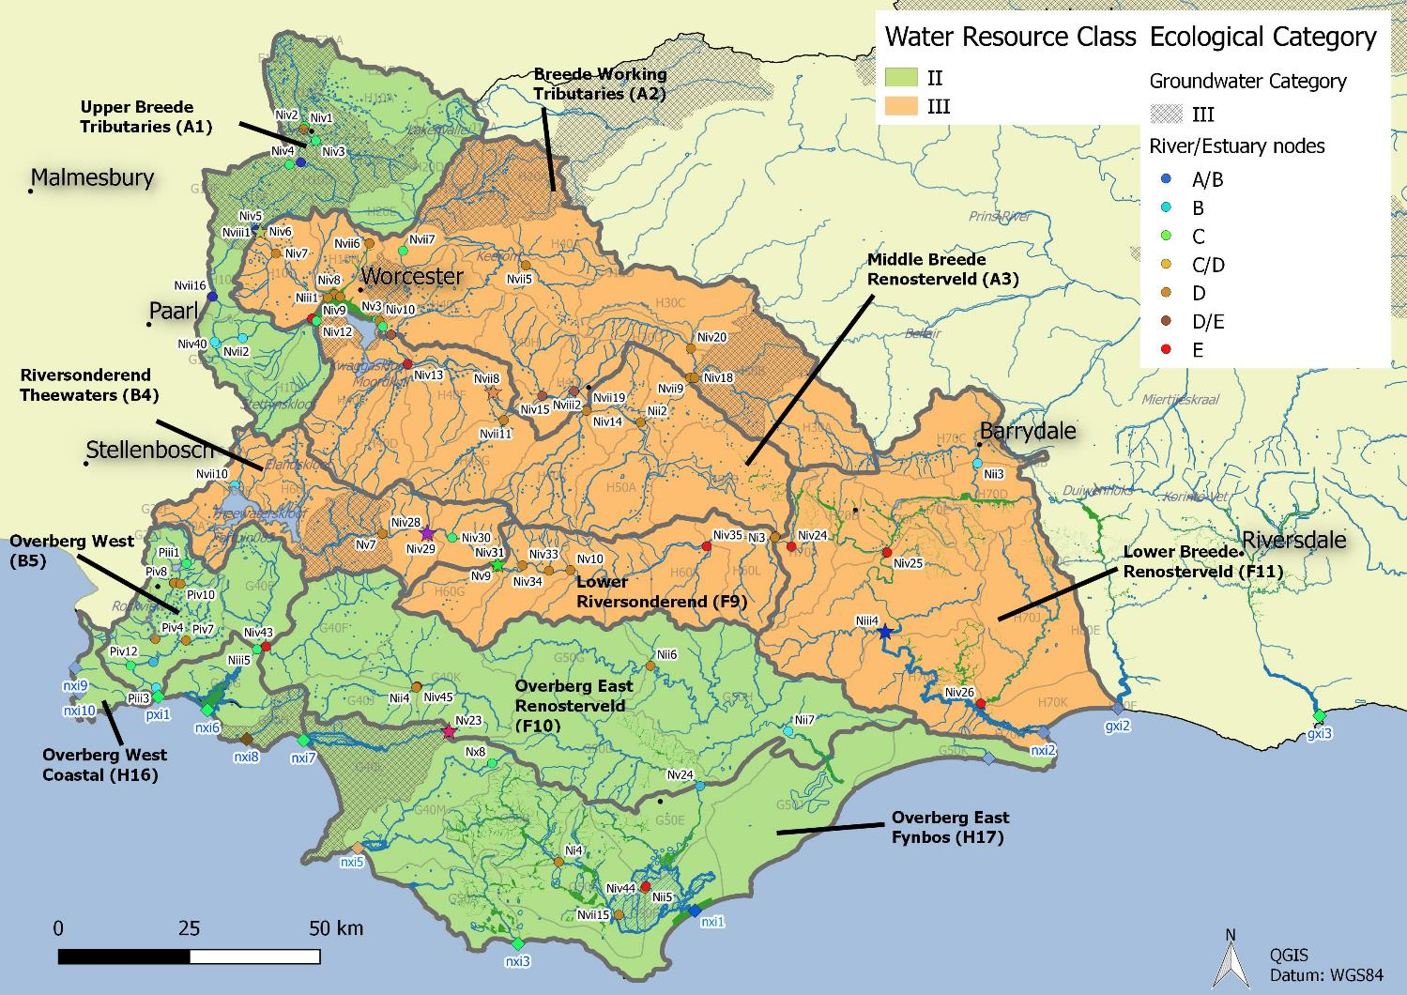
Breede-Overberg Region of the WMA
Bredasdorp
Breede-Overberg Region

Slide 18
Breede-Overberg Region
 | Integrated Unit of Analysis (IUA) | Recommended Classes
 | A1 Upper Breede Tributaries | II
 | A2 Middle Breede Renosterveld | III
 | A3 Breede Working Tributaries | III
 | B4 Riversonderend Theewaters | III
 | F9 Lower Riversonderend | III
 | B5 Overberg West | II
 | H16 Overberg West Coastal | II
 | F10 Overberg East Renosterveld | II
 | H17 Overberg East Fynbos | III
 | F11 Lower Breede Renosterveld | II

Slide 19
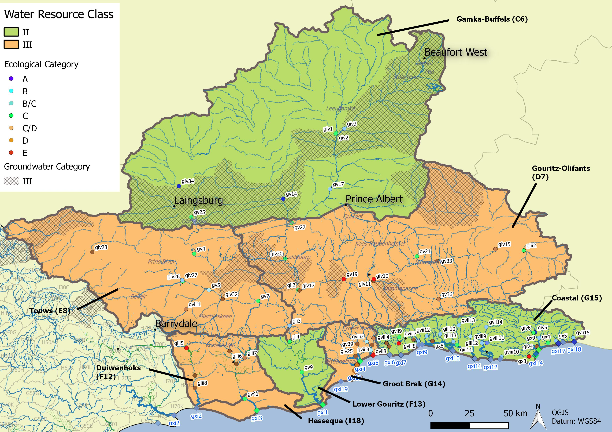
Gouritz-Coastal Region of the WMA

Slide 20
Gouritz-Coastal Region
 | Integrated Unit of Analysis (IUA) |  | Recommended Classes
 | Gamka Buffels | C6 | II
 | Touws | E8 | III
 | Gouritz-Olifants | D7 | III
 | Lower Gouritz | F13 | II
 | Duiwenhoks | F12 | III
 | Hessequa | I18 | III
 | Groot Brak | G14 | III
 | Coastal | G15 | II

Slide 21
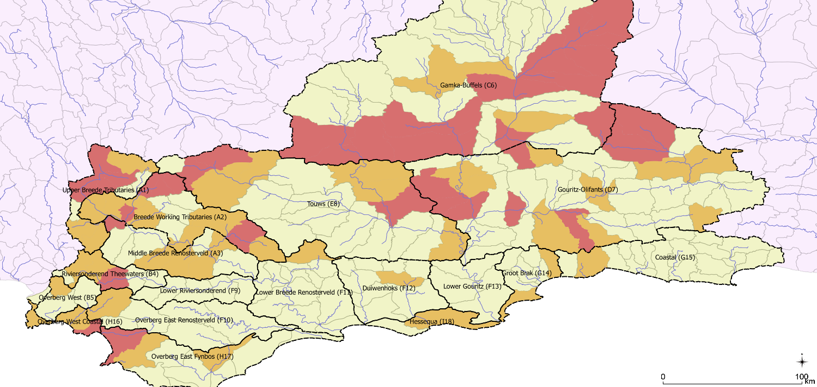

Impacts on groundwater
Increase in status at 4 quats in the Upper Breede Tributaries IUA
2 of these have significant increase.
None are high GWBF/EWR
Moderate increase in status at 7 quats in the Gouritz-Olifants IUA
4/7 change from I to III
None are high GWBF/EWR
Groundwater category
Moderate increase in status at 4 quats in the Overberg West / Coastal IUA
One quat has high GWBF/EWR: to be managed with RQOs
Notes:
Olifants IUA
KKRWSS & Calitzdorp

Slide 22
5.4 Proposed RQOs

Slide 23
Task 4: Determine Resource Quality Objectives
Link between Classes & RQOs
Classification:
Proposed Scenario
(RUs with Targeted ECs (TECs) for water resources, per IUA class)
Resource Quality Objectives (RQOs):
Resource Unit prioritisation
Resource Unit evaluation
Define RQOs & Numerical Limits
Define Monitoring Program

Slide 24
Task 4: Determine Resource Quality Objectives
Evaluation of RUs - method
Customised DWS RQO Tools are used to prioritise RUs & then identify selected indicators for prioritised RUs, for which RQOs (descriptive and numerical) are written, by identifying:
  Components
  Sub-components
  Indicators
Quantity, Quality
Habitat, Biota
Notes:
Evaluation of Rus method statement

Slide 25




Example of indicators: River Example
Component |  | Sub-Component | Indicator example
 | QUANTITY | Flow | Water level recovers from abstraction impact during wet season, under consideration of climate change and drought cycles
 | QUALITY | Nutrients | NO₃/NO₂
 | HABITAT | Geomorphology | Sediment particle size (D₅₀)
 | BIOTA | Macroinvertebrates | SASS and ASPT scores

Slide 26
RQO terminology
Prioritised Resource Unit per IUA:
i.e. grouped areas e.g. river basins, deemed similar in terms of various characteristics
Component/ Sub-component:
  E.g. Quantity/ Flow
Indicator:
  Representation of trend tracking the measurable change in a system over time. Focuses on a small manageable set of information
Resource Quality Objective (RQO):
  Descriptive broad statements describing overall objectives for the Resource Unit
Numerical limit:
  Quantitative descriptors of different components of the Resource Unit

Slide 27
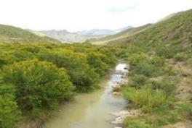
Rivers
 | Component | Sub-component
 | QUANTITY | High flows
 |  | Low flows
 | WATER QUALITY | Nutrients
 |  | Salts
 |  | System variables (temperature, salinity, oxygen, pH, turbidity
 |  | Toxins
 |  | Pathogens
 | HABITAT | Geomorphology
 |  | Vegetation/Riparian vegetation
 | BIOTA | Fish
 |  | Invertebrates
Notes:
Karl to present

Slide 28
River RQOs
Detailed RQOs for 37 River RUs
Hydrology and Ecological Category for all River Rus
Table and maps indicating ecological infrastructure

Slide 29
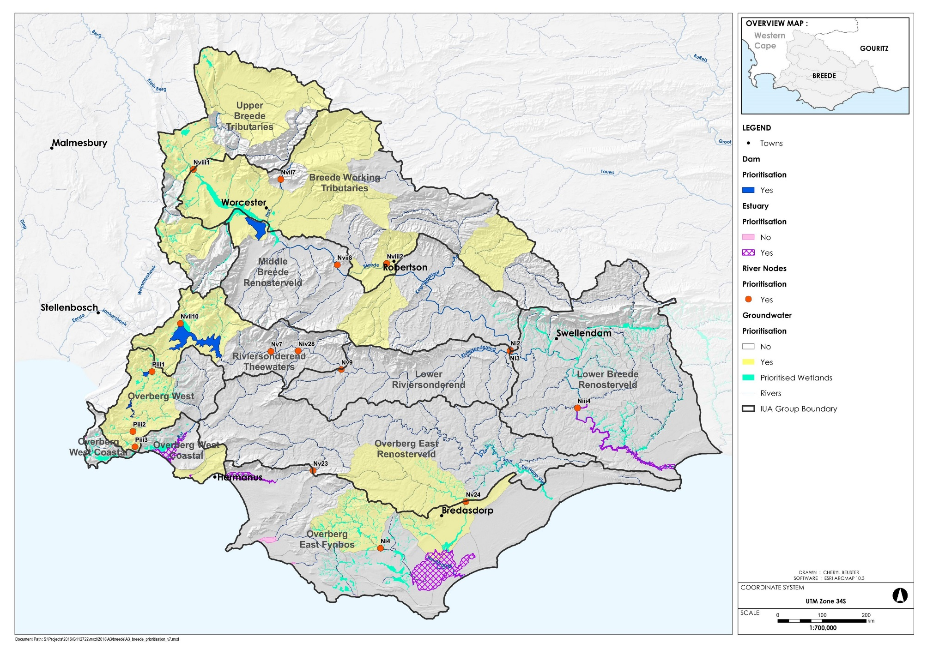
Breede-Overberg River sites for RQOs

Slide 30
Breede-Overberg River sites for RQOs

Slide 31
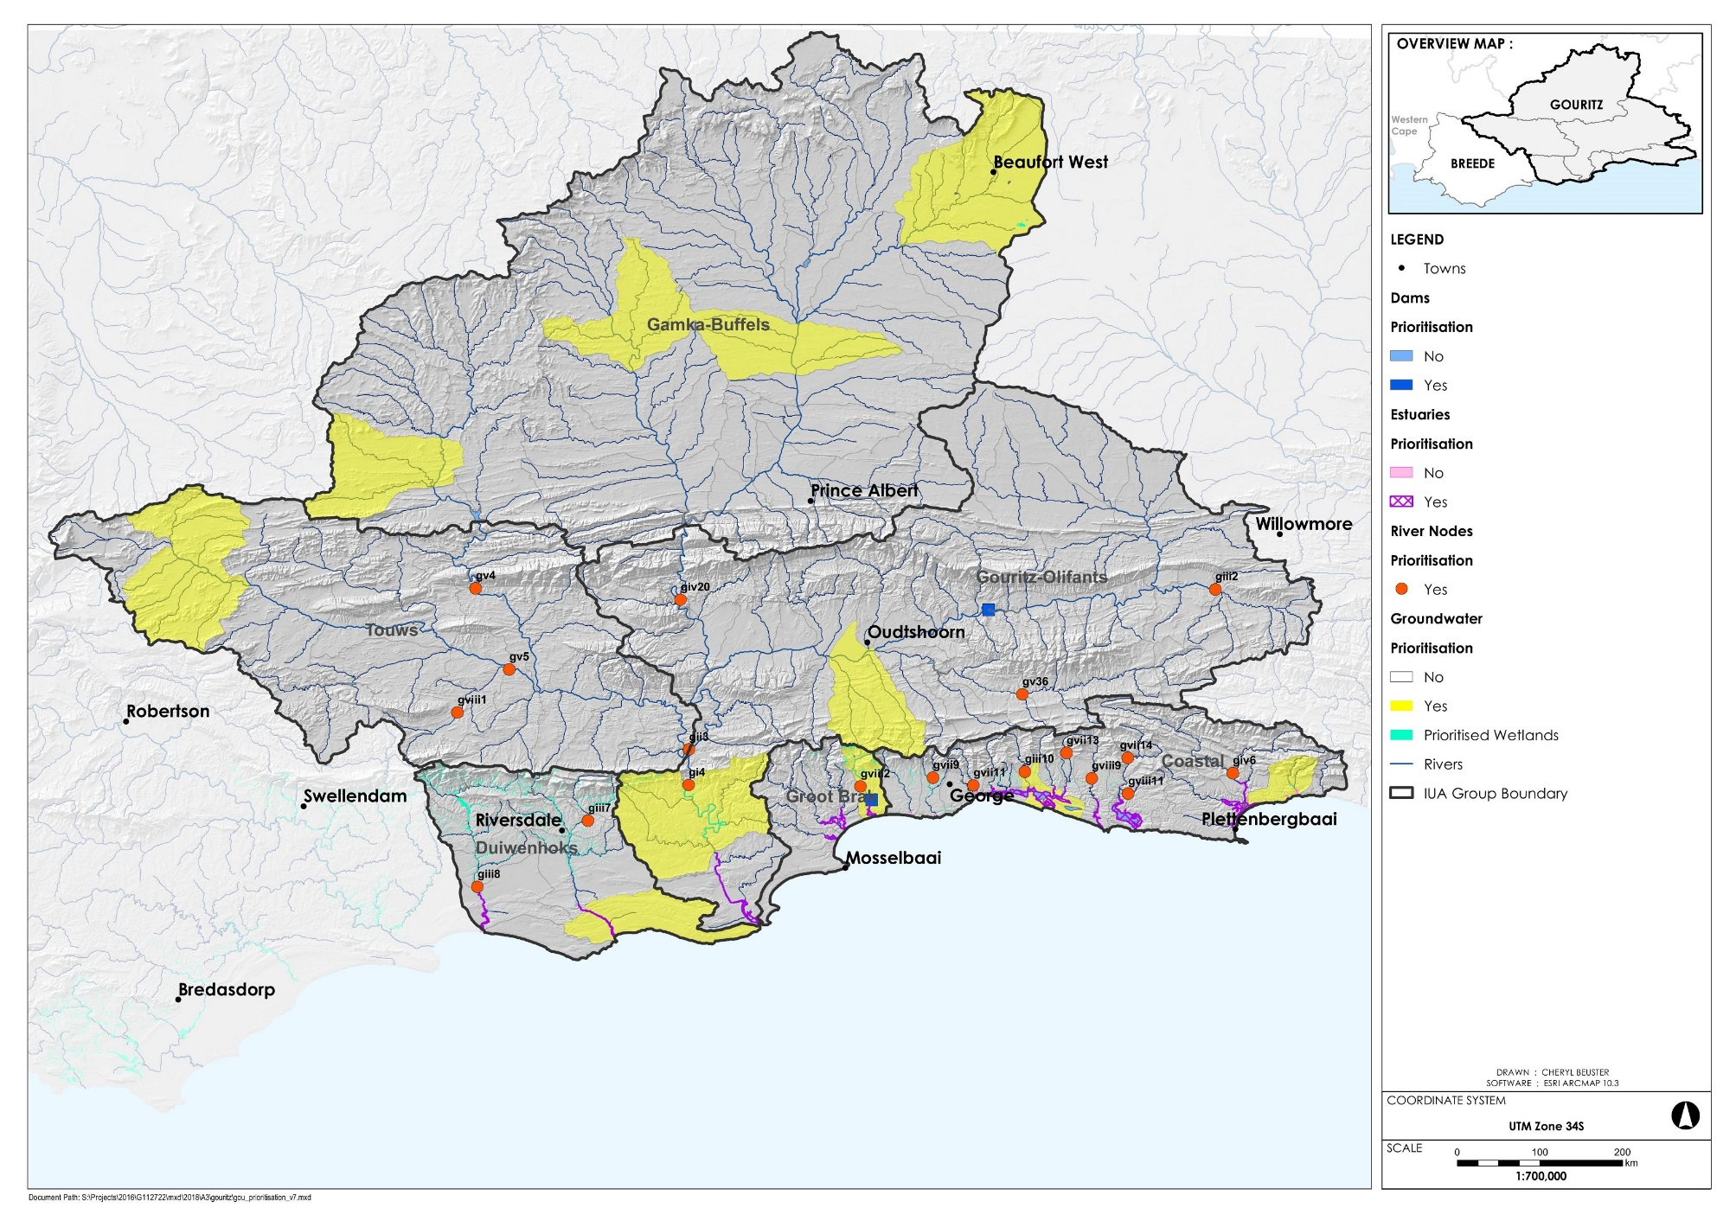
Gouritz-Coastal River sites for RQOs

Slide 32
Gouritz-Coastal River sites for RQOs

Slide 33
Gouritz-Coastal River sites for RQOs

Slide 34
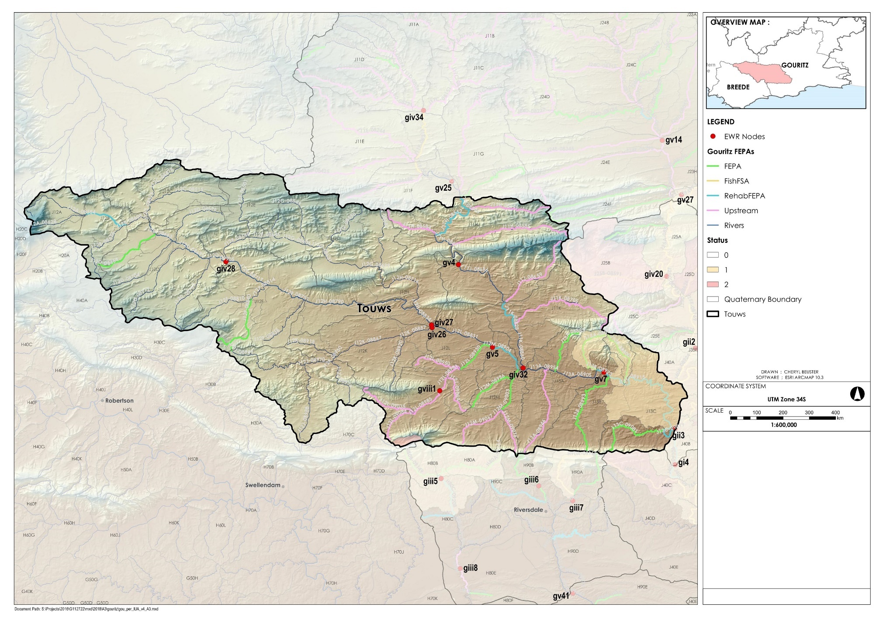
Example: Doring River (gviii1)

Slide 35
EXAMPLE: Doring River @ GOUR_DORI_J12L
QUANTITY: Flow – excludes inter-annual floods
Notes:
These are the hydrological RQOs, a standard summary table output from the Reserve Desktop model. The data are presented relative to natural because that is how EWRs are calculated. So you can see here, the TOTAL % assigned to the annual EWR, that is then split into low, drought and high flow percentages and volumes.
These are then compared further to the natural flows monthly and again provided in the same flow categories.
The total flows are the sum of the maintenance lows and highs, the drought flows are for extreme dry conditions.

Slide 36
EXAMPLE: Doring River @ GOUR_DORI_J12L
Water Quality
Sub-component | TEC | RWQO | Indicator | Numerical Limits | Present state (50/95%tile) J1H018Q01
Nutrients | C | Maintain in a mesotrophic (moderately enriched) or better condition. | Phosphate (PO₄-P) Total inorganic nitrogen (TIN) | Median ≤ 0.075 mg/l PO₄-P Median ≤ 1.75 mg/l TIN | PO4 0.010 / 0.024 TIN 0.058 / 0.183
Salts |  | Salt concentrations should be maintained at present day levels. | Electrical conductivity (EC) | 95th %tile ≤ 1500 mS/m EC | EC 873 / 1440
System variables |  | pH, temperature, and dissolved oxygen are important for the maintenance of ecosystem health. | pH Dissolved oxygen | 6.5 ≥ pH ≤ 8.5 5th percentile ≥ 6 mg/l DO | pH 8.2 / 8.5 No DO data
Toxins |  | Toxicity not pose a threat to aquatic ecosystems. | None specified as it is not a concern in this RU |  | No data
Pathogens |  | Maintained in an Acceptable category for full contact recreation. | Escherichia coli | 95%tile ≤ 165 cfu/100ml E coli | No data

Slide 37
EXAMPLE: Doring River @ GOUR_DORI_J12L
BIOTA: Riparian vegetation
Notes:
These are the riparian vegetation RQOs
They are separated into three categories, one for each lateral zone.
The marginal zone, where the plants have their feet wet, the lower zone, being the main riparian area with trees and shrubs, and then the upper zone, being the mixing area between the riparian area and the terrestrial community up the slope.
So you have the RQO, being the range of conditions that should persist over time, and then you have the TPC, threshold of potential concern, which represents the lowest value beyond which management actions should kick in.
Since the marginal zone if regularly flooded you can see there is no provision for terrestrial plants there nor for exotic species.
The RQOs are separated into non-woody (grasses, rushes, restios and reeds) and woody (trees and shrubs).
These allow for more terrestrial species higher up the bank.
The data are based on the current conditions and either maintaining these if the trajectory was stable or improving it if the trajectory was upwards.

Slide 38
EXAMPLE: Doring River @ GOUR_DORI_J12L
BIOTA: Macroinvertebrates
Notes:
These are the macroinvertebrate RQOs.
First up are the SASS scores, the Total SASS score and the Average Score per Taxon (ASPT). So here the SASS score need to remain higher than 90 and the ASPT must be higher than 4.5. Scores lower then these will trigger the TPCs and initiate a response.
There is also a description of the # of families that must be present, in this case more than 15 in total and their abundances must be between A (2-10) and C (> 100). If there are fewer than 15 families and if there are only 1 individual present of and of these then the TPC will be triggered.

Slide 39
EXAMPLE: Doring River @ GOUR_DORI_J12L
BIOTA: Fish
Notes:
These are the fish RQOs.
First up it lists the indigenous fish that must be present, 4 in this case. The TPC is triggered if there are fewer then 2 of the species present.
Then, each of these is given a FROC value which is not an absolute percentage but a range:
1 present at < 10%
2 10-25%
3 >25-50
4 > 50-75
5 >75%
There are also specifications for juveniles in the case of the large cyprinids.

Slide 40
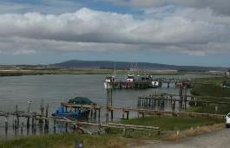
Estuaries
 | Component | Sub-component
 | QUANTITY | High flows
 |  | Low flows
 | WATER QUALITY | Nutrients
 |  | Salts
 |  | System variables (temperature, salinity, oxygen, pH, turbidity
 |  | Pathogens
 | HABITAT | Hydrodynamics
 |  | Sediments
 | BIOTA | Fish
 |  | Invertebrates
 |  | Micro-algae
 |  | Macrophytes
Notes:
Barry to present

Slide 41
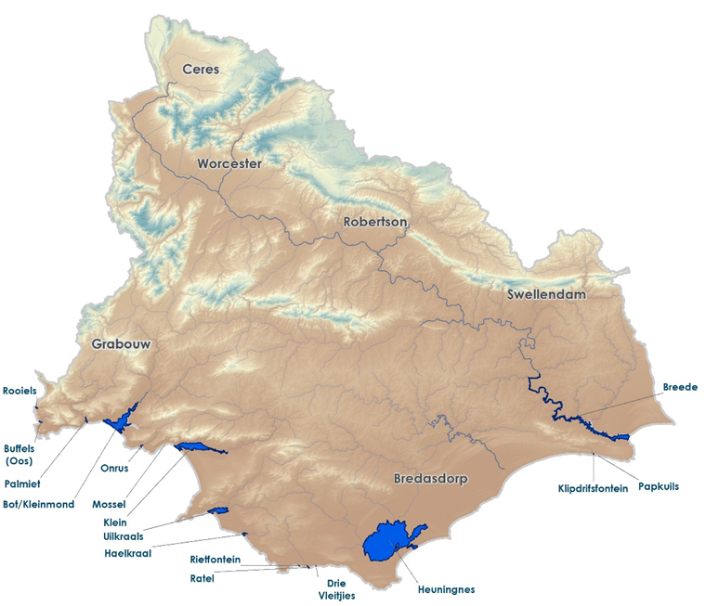
Estuaries in the Breede Overberg Region

Slide 42
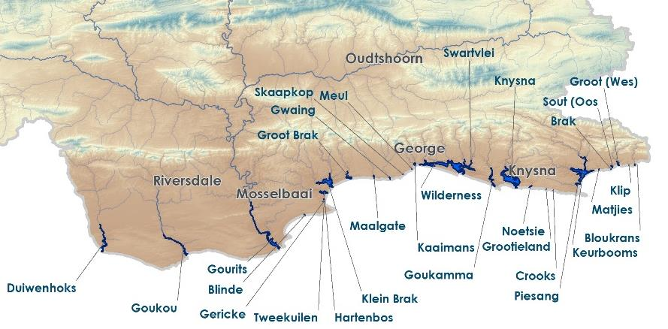
Estuaries in the Gouritz region

Slide 43
Estuary Health Index
% similarity to Reference
0
20
40
60
75
90
100
F
E
D
C
B
A
EHI

Slide 44
Estuary RQO Template - Hartenbos
IUA |  | Node | Quat | REC |  | Current |  | Target
 |  |  |  | EC | %nMAR | PES | %nMAR | EC | %nMAR
G14-Groot Brak |  | Gxi22 | K10B | C | 80.7 | D | 65.0 | C | 65.0
MOTIVATION FOR ACHIEVING REC/TEC
The Hartenbos estuary is considered to be of “average importance” from a biodiversity conservation perspective (ranked 75 out of 273 estuaries in South Africa) and has not been included on the list of existing or desired protected areas (Turpie et al. 2012). The system is nonetheless important from a socio-economic perspective – it is an important node for recreation, tourism and contributes significantly to property value. It is also important to maintain the system in a state of health that is safe for contact recreation. The REC for the estuary is thus a C, one category higher than present. However, it has been determined that water abstraction from this system cannot be reduced in future without compromising requirements for other users in this region. The MAR for the Target Ecological Condition thus remains as for present (65.0%). The most important threats to the Hartenbos estuary include freshwater deprivation (due to abstractions from the Hartbeeskuil Dam, for agricultural and domestic use), sedimentation (due to reduced flow and concomitant changes in mouth dynamics) and impaired water quality (due to agricultural return flows and poor quality of stormwater from informal settlements). Given that it is not possible to restore flows required to achieve the REC, concerted effort on the part of DWS and other stakeholders (local, provincial and other national government agencies) is thus required to address other threats to the estuary in accordance with the Ecological Specifications included below, thereby facilitating its restoration to the REC.
Component | SPECIFICATIONS
Flow | %nMAR: 65.0, dry season flow >0.05 Mm³/month
Mouth condition | % time mouth closed should not increase/decrease by >10% from present; no period of closure >3 months
Water quality | DIN not to exceed 200 μg/ℓ (average); DIP not to exceed 50 μg/ℓ (average)
Microalgae | Phytoplankton not to exceed 8 μg/ℓ (median), and/or 20 μg/ℓ (once-off) and/or cell density not to exceed 10 000 cells/ml (once-off) Benthic microalgae not to exceed 42 mg/m² (median)
Macrophytes (plants) | Maintain distribution of macrophyte habitats within 20% of present (Supratidal salt marsh: 29%, Reeds & sedges: 10%, sand/mud banks: 10%)
Invertebrates | Populations of key invertebrate species should not deviate from average baselines (as determined in first three visits) by more 30%
Fish | Relative contribution for key groups of fish (estuarine resident, marine migrant, freshwater, etc.) should not deviate from average baselines (as determined in first three visits) by more 30%
Birds | Number of birds in any group, other than species that are increasing regionally such as Egyptian geese, should not deviate by more than 30% from baseline median (determined by past data and/or initial surveys)

Slide 45
Estuary RQO Template – Hartenbos (cont’d)
IUA |  | Node | Quat | REC |  | Current |  | Target
 |  |  |  | EC | %nMAR | PES | %nMAR | EC | %nMAR
G14-Groot Brak |  | Gxi22 | K10B | C | 80.7 | D | 65.0 | C | 65.0
Additional (non-flow related) interventions to achieve the REC:
Dam construction has resulted in a reduction in base flow and floods to the system, with a shift in the onset of the high flow period and an increase in the duration of the low flow period; Artificial breaching; Loss of tidal flows and habitat as result of bridge construction (e.g. old N2, railway bridge); Infilling of estuary channel and mouth area as a result of loss of floods and artificial breaching; A significant reduction in water quality as a result of the Mossel Bay WWTW discharge and urban runoff; Development in the EFZ; Alien vegetation; Limited bait collection and fishing effort; and Human disturbance (which influences bird abundance).
Source of information | DWS (2015) Desktop Assessment of Estuaries in the Gouritz WMA

Slide 46
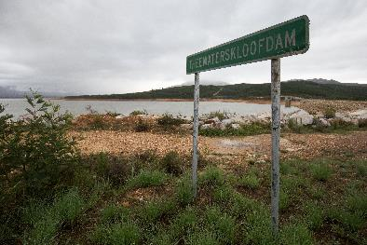
Dams
 | Component | Sub-component
 | QUANTITY | High flows
 |  | Low flows
 | WATER QUALITY | Nutrients
 |  | Salts
 |  | Pathogens
 | BIOTA | Fish
 |  | Phytoplankton
Notes:
Erik to present

Slide 47
Dam RQOs
8 Prioritised dams
Breede-Overberg area
  Theewaterskloof
  Greater Brandvlei
  Ceres-Koekedouw
  Eikenhof
  Kogelberg
  Arieskraal
Gouritz-Coastal area
  Stompdrift
  Wolwedans
Notes:
Erik to present

Slide 48
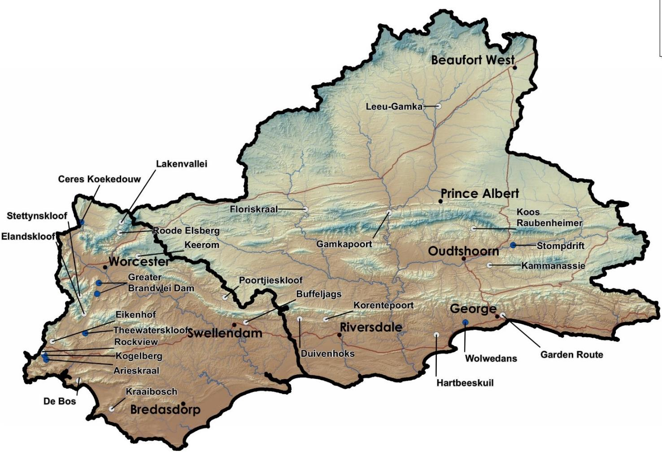
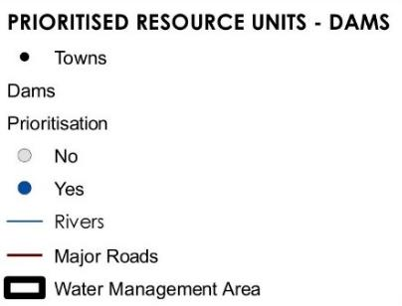
High and low priority RUs
Dam RQOs

Slide 49
Ceres Koekedouw Dam
(IUA A1 Upper Breede Tributaries)
The dam supplies water for irrigation (Ceres-Koekedouw WUA), and to the town of Ceres for urban and industrial water use.
The dam is located in a mountainous area. A number of small dams are located in the upstream irrigation areas which will impound low flows. No change is expected for future impacts.
Limited capacity of outlet works.
While there is no EWR site located downstream, the raising of the dam was approved subject to a water release pattern which is being implemented and monitored.

Slide 50
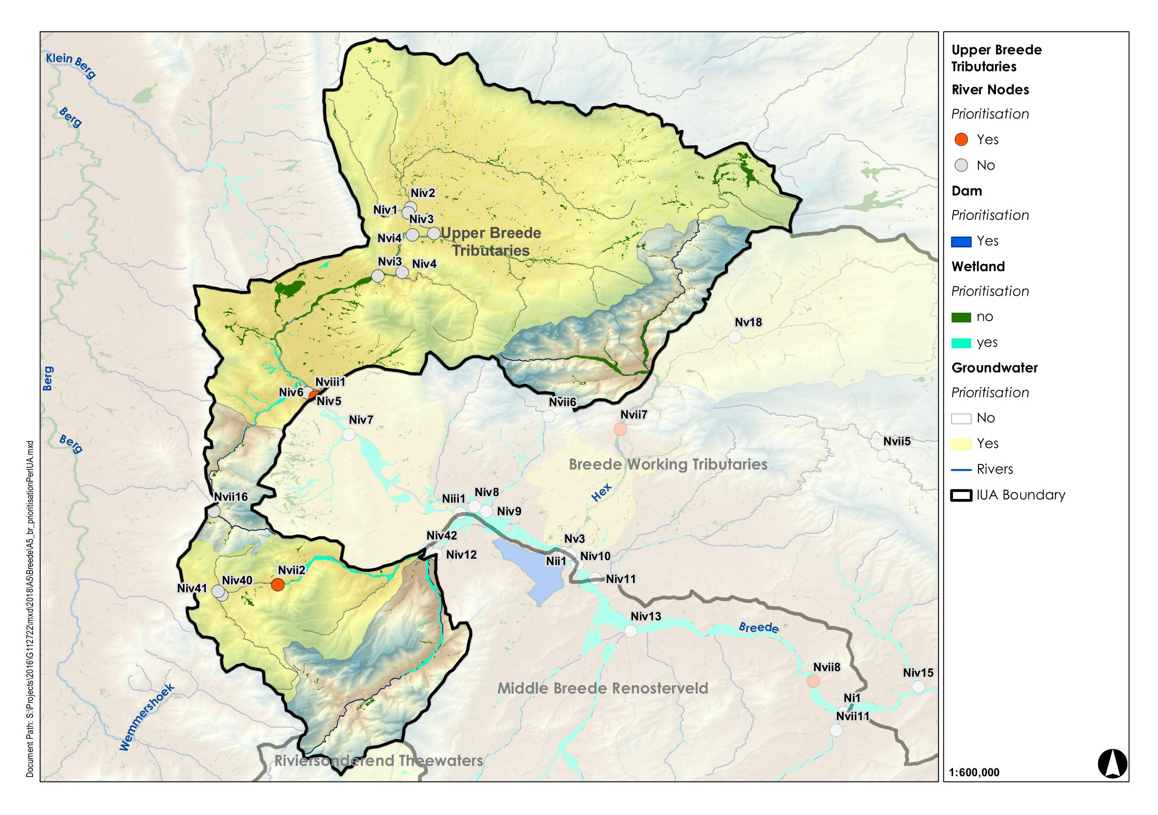
Ceres Koekedouw Dam (IUA A1 Upper Breede Tributaries)
Ceres-Koekedouw Dam

Slide 51
Ceres Koekedouw Dam
(IUA A1 Upper Breede Tributaries)
Sub-comp. | Rationale for sub-component choice | Indicator selection
Low flows | Dam levels must be sufficient for releases for use and protection of ecosystem function downstream, within the constraint of limited-capacity outlet works | Dam levels
Nutrients | The system must be maintained in a oligotrophic state or better | Ortho-phosphate, total inorganic nitrogen
Salts | Salt levels must be maintained at concentrations where they do not impact negatively on the ecosystem, are acceptable for municipal treatment and Ideal for irrigation use | Electrical conductivity
Fish | The wellbeing of the fish community of this artificial ecosystem must be maintained in a suitable condition to contribute to regional biodiversity and support recreational angling. Consumption of fish must not pose a health risk | Implementation of the Index of Reservoir Habitat Impairment (IRHI) by Miranda and Hunt (2011), fish health evaluation. Indigenous fish populations.

Slide 52
Quantity & Biota RQOs for Ceres Koekedouw Dam
Sub-comp. | RQO Narrative description | Indicator/ measure | Numerical limits | TPC
Low flows | Dam levels must be sufficient for releases for irrigation and human use, within the constraints of limited capacity outlet works | Dam levels | % of live storage. Agreed ecological release flow pattern and rate (condition of dam raising). | Not applicable
Fish | The wellbeing of the fish community of this artificial ecosystem must be maintained in a suitable condition to contribute to regional biodiversity and to support local recreational angling. Consumption of fish must not pose a health risk | Implementation of the Index of Reservoir Habitat Impairment (IRHI) by Miranda and Hunt (2011) Populations of indigenous fish | Habitat suitability and fish wellbeing in a state which is equivalent to a C or better ecological category. Fish demographics and species assemblage of indigenous fish should be the same or better than the baseline status. | To be established from baseline. Dam storage < 5% for rescue of drought-threatened indigenous fish species.

Slide 53
Quality RQOs for Ceres Koekedouw Dam
Sub-comp. | RQO Narrative description | Indicator | Numerical Limits | Threshold of Potential Concern | Present state (50/95%tile) H1R003Q01
Nutrients | The system must be maintained in an oligotrophic state or better. | Ortho-phosphate (PO₄-P) | Median ≤ 0.015 mg/ ℓ P | 0.010 mg/ ℓ P | PO4-P 0.007 / 0.017
 |  | Total inorganic nitrogen (TIN) | Median ≤ 0.70 mg/ℓ N | 0.60 mg/ℓ N | TIN 0.12 / 0.27
Salts | Salt concentrations are low, in an Ideal category, and should must be maintained at concentrations where they do not impact negatively on the ecosystem, are acceptable for municipal treatment and rural use, and Ideal for irrigation use. | Electrical conductivity | 95th percentile ≤ 40 mS/m | 35 mS/m | EC 4.6 / 8.8

Slide 54
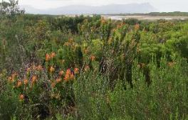
Wetlands
 | Component | Sub-component
 | QUANTITY | High flows
 |  | Hydroperiod
 | WATER QUALITY | Nutrients
 | HABITAT | Geomorphology
 |  | Vegetation
 | BIOTA | Birds
 |  | Frogs
 |  | Diatoms
 |  | Phytoplankton
 |  | Invertebrates
Notes:
The determination of which wetlands to take forward for RQOs relied on first prioritising wetlands in the WMA. Wetlands were quite different to the other Resources, in that there has not been detailed studies and information available about most systems (even very important ones). It was therefore important to develop a conceptualisation of the important drivers for wetland types: hydrology and geomorphology followed by vegetation. An understanding of each Wetland Resource Unit using this conceptualisation helped when defining sub-components and indicators for monitoring.

Slide 55
Wetland RQOs
Hydro-geomorphic Unit
RU | Wetland Name | HGM
A1-W01 | Strategic Water Source wetlands | SEEP
A2-W02 | East Coast Shale Renosterveld Channelled Floodplain (Papenkuils) | FLOODPLAIN
A3-W03 | East Coast Shale Renosterveld Floodplain (Breede) | FLOODPLAIN
F11-W04 | East Coast Shale Renosterveld Floodplain (Breede) | FLOODPLAIN
B4-W05 | Strategic Water Source wetlands | SEEP
B5-W06 | Strategic Water Source wetlands | SEEP
F10-W08 | Southwest Ferricrete Fynbos Floodplain (Kars) | FLOODPLAIN
H16-W09 | Southwest Sand Fynbos Channelled Valley Bottom (Kleinmond) | CHANNELLED VALLEY BOTTOM
H16-W10 | Strategic Water Source wetlands | SEEP
H17-W11 | Southwest Ferricrete Fynbos Floodplain | FLOODPLAIN
 | Southwest Ferricrete Fynbos Flat | FLAT
 | Southwest Ferricrete Fynbos Depression | DEPRESSION
H17-W12 | East Coast Shale Renosterveld Floodplain (De Hoop) | FLOODPLAIN
H17-W13 | South Strandveld Western Strandveld FLAT/SEEP (Heuningnes) | FLAT/SEEP
C6-W14 | Upper Nama Karoo Depression | DEPRESSION
C6-W15 | Lower Nama Karoo Depression | DEPRESSION
E8-W16 | Strategic Water Source wetlands | SEEP
F13-W17 | Albany Thicket Floodplain (Gouritz) | FLOODPLAIN
F12-W18 | East Coast Shale Renosterveld Channelled Valley Bottom (Goukou) | CHANNELLED VALLEY BOTTOM
F12-W19 | East Coast Shale Renosterveld Channelled Valley Bottom (Duiwenhoks) | CHANNELLED VALLEY BOTTOM
G15-W20 | Freshwater Lake (Groenvlei) | LAKE
G15-W21 | Freshwater Lake (Wilderness) | LAKE
G15-W22 | Strategic Water Source wetlands | SEEP
 |  | 21

Slide 56
Wetland RQOs
Wetland HGM type | Driver |  |  |  | Driver/Responder | Responder
 | QUANTITY |  | HABITAT | WQ | HABITAT | BIOTA
 | Flow | Hydroperiod | Geomorphology | Water Quality | Vegetation | Diatoms* | Fish | Birds | Frogs
Floodplain | xx | xx | xx | x | x | x | x | x | x
Channelled Valley-Bottom |  | xx | xx | x | x | x | x | x | x
Unchannelled Valley-Bottom |  | xx | xx | x | x | x |  | x | x
Seep |  | xx | xx | x | x | x |  | x | x
Depression |  | xx | xx | x | x | x |  | x | x
Flat |  | xx |  | x | xx | xx |  | x | x
7 Floodplain
3 CVB
7 Seep
3 Depression
2 Flat
2 Lake

Slide 57
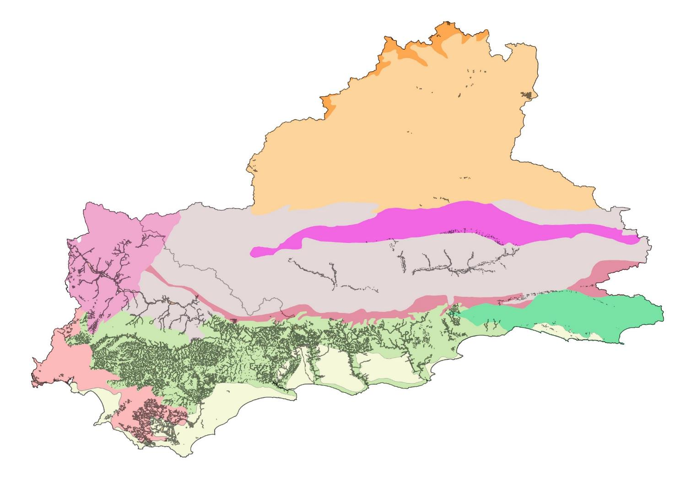
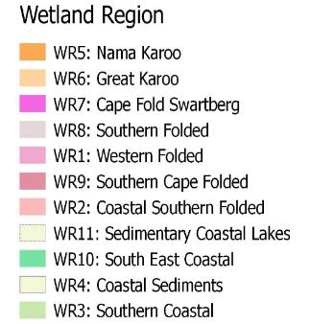
Resource Unit Prioritisation – Wetland Regions
  Typically small seeps and river-linked wetlands
  Typically seeps with a likely high degree of groundwater dependence
Beaufort West
  Typically small seeps and river-linked wetlands with a likely high degree of direct and indirect groundwater dependence
Typically small seeps associated with groundwater-fed springs
  Typically seeps and depressions as well as river-linked wetlands
Prince Albert
  Typically valley bottom and floodplain wetlands
Oudtshoorn
Worcester
Knysna
Riversdale
  Typically valley-bottom wetlands and seepage wetlands
  Typically lakes and wetland flats
  Typically seeps and depression wetlands as well as valley bottom and floodplain wetlands
Bredasdorp
  Typically valley bottom wetlands
Wetlands are infrequent, possibly due to deep infiltrating soils and a lack of shallow/perched water tables. Inter-dune depressional wetlands and present suggesting groundwater contributions
Notes:
The wetland regions are indicative of underlying geological as well as climatic controls. Different regions would therefore have different wetland types typical to those underlying drivers.

Slide 58
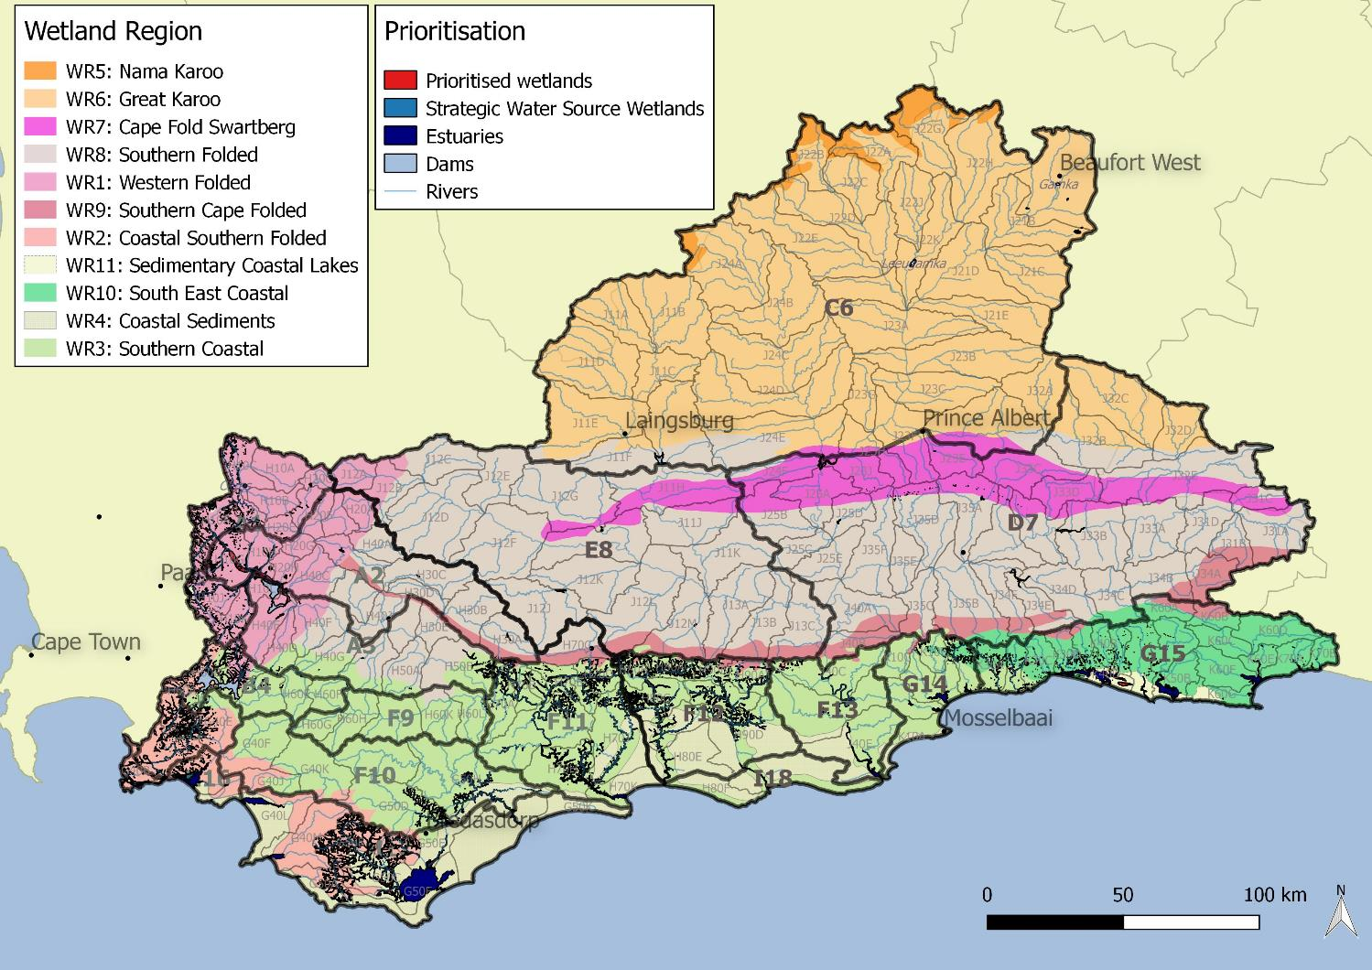
Resource Unit Prioritisation
Notes:
Incorporating all the different layers indicated that there was a good representivity of wetlands across the WMA.

Slide 59
Characteristics of different Wetland Types
Quantity
Flow
Water retention & distribution (Hydroperiod)
Type | High flows | Baseflow | Surrounding runoff
Floodplain | x | x | x
Channelled Valley-Bottom |  | x | x
Unchannelled Valley-Bottom |  | x | x
Seep |  | x | x
Depression |  | x | x
Flat |  | x | x
Maintain high flow events
Maintain water levels
Notes:
In terms of hydrological functioning, this may relate to flow or water retention and distribution depending on wetland type. For instance floodplain wetlands rely on high flow events, whilst a depression or seep are linked to surrounding runoff or baseflow.

Slide 60
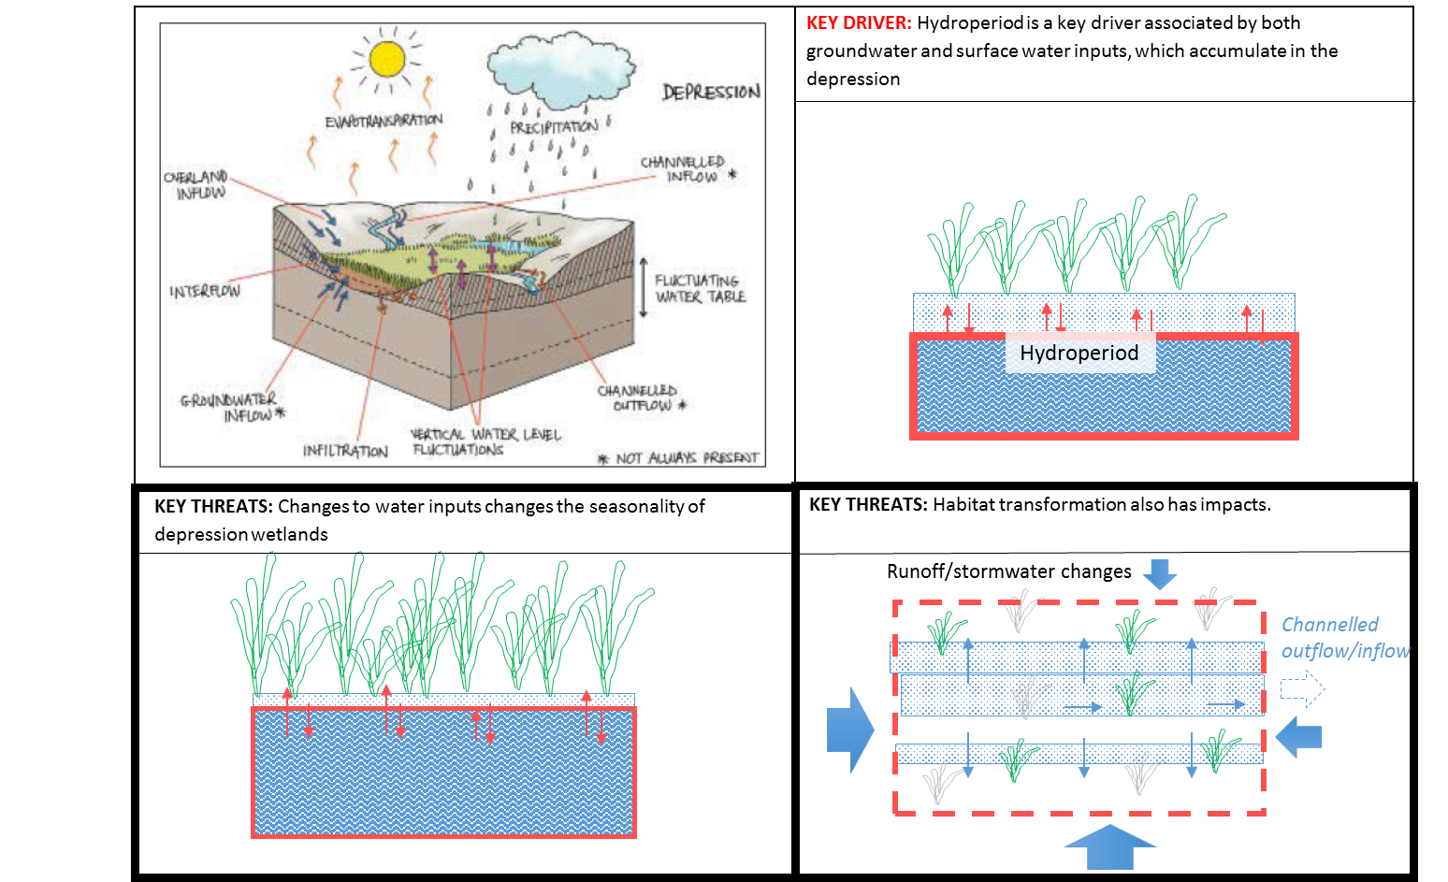
DEPRESSION vs FLOODPLAIN Wetland

Slide 61
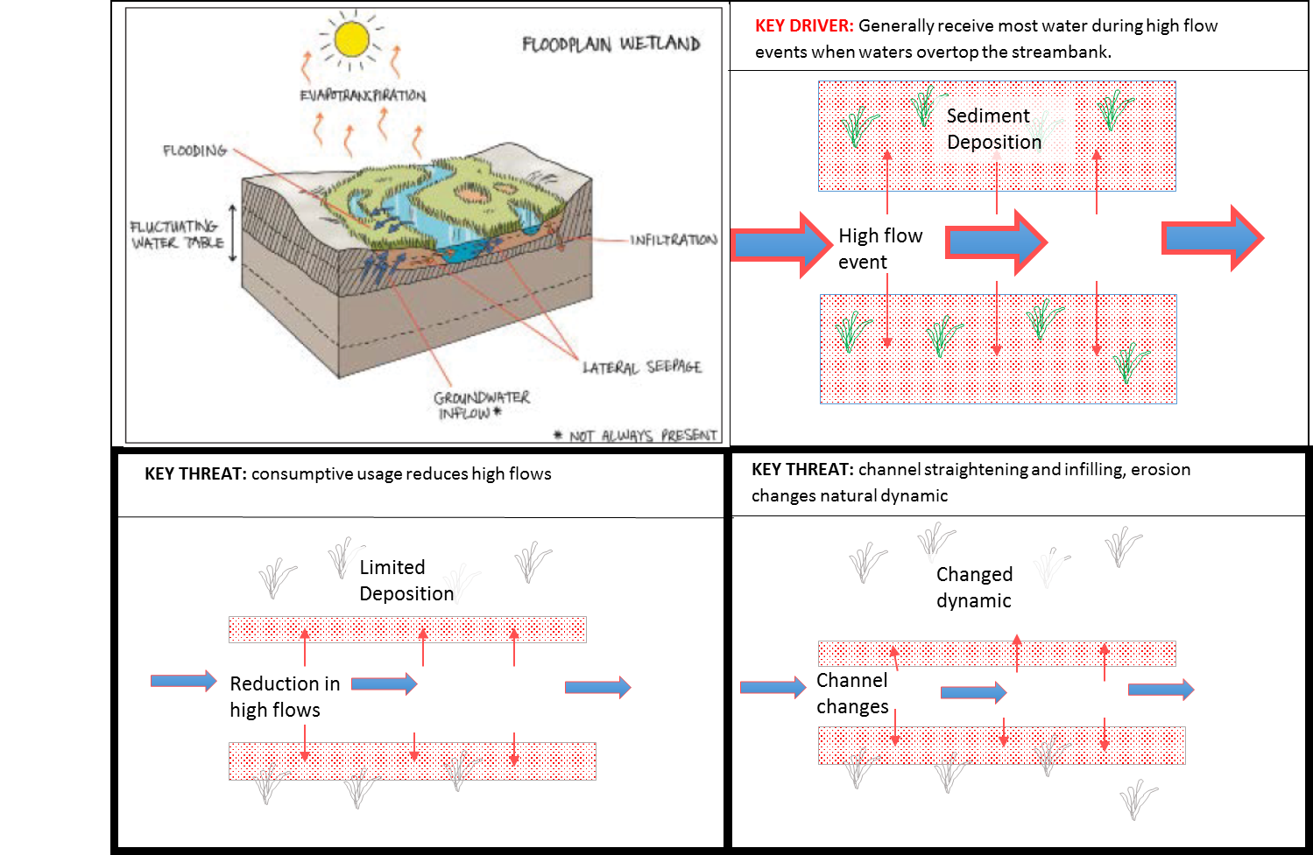
DEPRESSION vs FLOODPLAIN Wetland

Slide 62
Example of DEPRESSION vs FLOODPLAIN wetland RQO
IUA | Class | RU | Wetland Name | Wetland Region | Component | Sub-component | RQO | Indicator/ measure | Numerical limits
C6 Gamka Buffels | II | C6-W15 | Lower Nama Karoo DEPRESSION | WR6 Great Karoo | Quantity | Hydroperiod | Depression wetlands require inputs from surrounding runoff, and interflow, in order to provide wetting regime required for supporting wetland vegetation. | Wetland extent | Define wetland extent and monitor every 5 years.
 |  |  |  |  | Habitat | Vegetation | Wetland vegetation must be maintained or where necessary improved in order to provide NFEPA cluster connectivity. | Natural vegetation versus alien invasive vegetation | Define natural vegetation versus alien invasive vegetation and monitor every 5 years.
 |  |  |  |  | Biota | Diatoms | Diatom presence indicative of water quality. | Diatom presence | Diatom assessment and monitor every 5 years.
 |  |  |  |  | Biota | Invertebrates | Presence of certain invertebrate taxa indicative of salinity, hydroperiod and acidity. | Invertebrate presence | Invertebrate assessment and monitor every 5 years.
IUA | Class | RU | Wetland Name | Wetland Region | Component | Sub-component | RQO | Indicator/ measure | Numerical limits
F10 Overberg East Renosterveld | II | F10-W08 | Southwest Ferricrete Fynbos FLOODPLAIN (Kars) | WR8 Southern Coastal | Quantity | Flow | High flows need to be maintained in order to overtop banks and inundate floodplain vegetation. | High flow | High flow at upstream river nodes to be maintained.
 |  |  |  |  | Habitat | Geomorphology | Floodplain acting as a deposition zone for sediment during high flow events. | Sediment accumulation | Geomorphological assessment and monitor every 5 years.
 |  |  |  |  | Habitat | Vegetation | Critically endangered wetland vegetation must be maintained or where necessary improved in order to protect the floodplain vegetation. | Natural vegetation versus alien invasive vegetation | Define natural vegetation versus alien invasive vegetation and monitor every 5 years.
 |  |  |  |  | Biota | Amphibians & reptiles | Populations of frog must be maintained at least at current levels to meet NFEPA frog conservation targets. | Frog presence | N/A
Notes:
This understanding of the wetland indicates that Quantity: water distribution and retention patterns and Habitat: geomorphology and vegetation are the important sub-components of this wetland resource unit. The indicator for these would therefore be related to flow concentration, as it is important for water to be retained and move slowly through the wetland. Managing erosion and alien invasive plants is related to managing flow concentration.

Slide 63
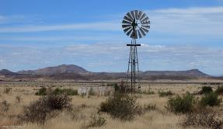
Groundwater
 | Component | Sub-component
 | QUANTITY | Abstraction
 |  | Low flows
 |  | Discharge
 | WATER QUALITY | Nutrients
 |  | Salts
 |  | Pathogens
Notes:
Helen to present

Slide 64
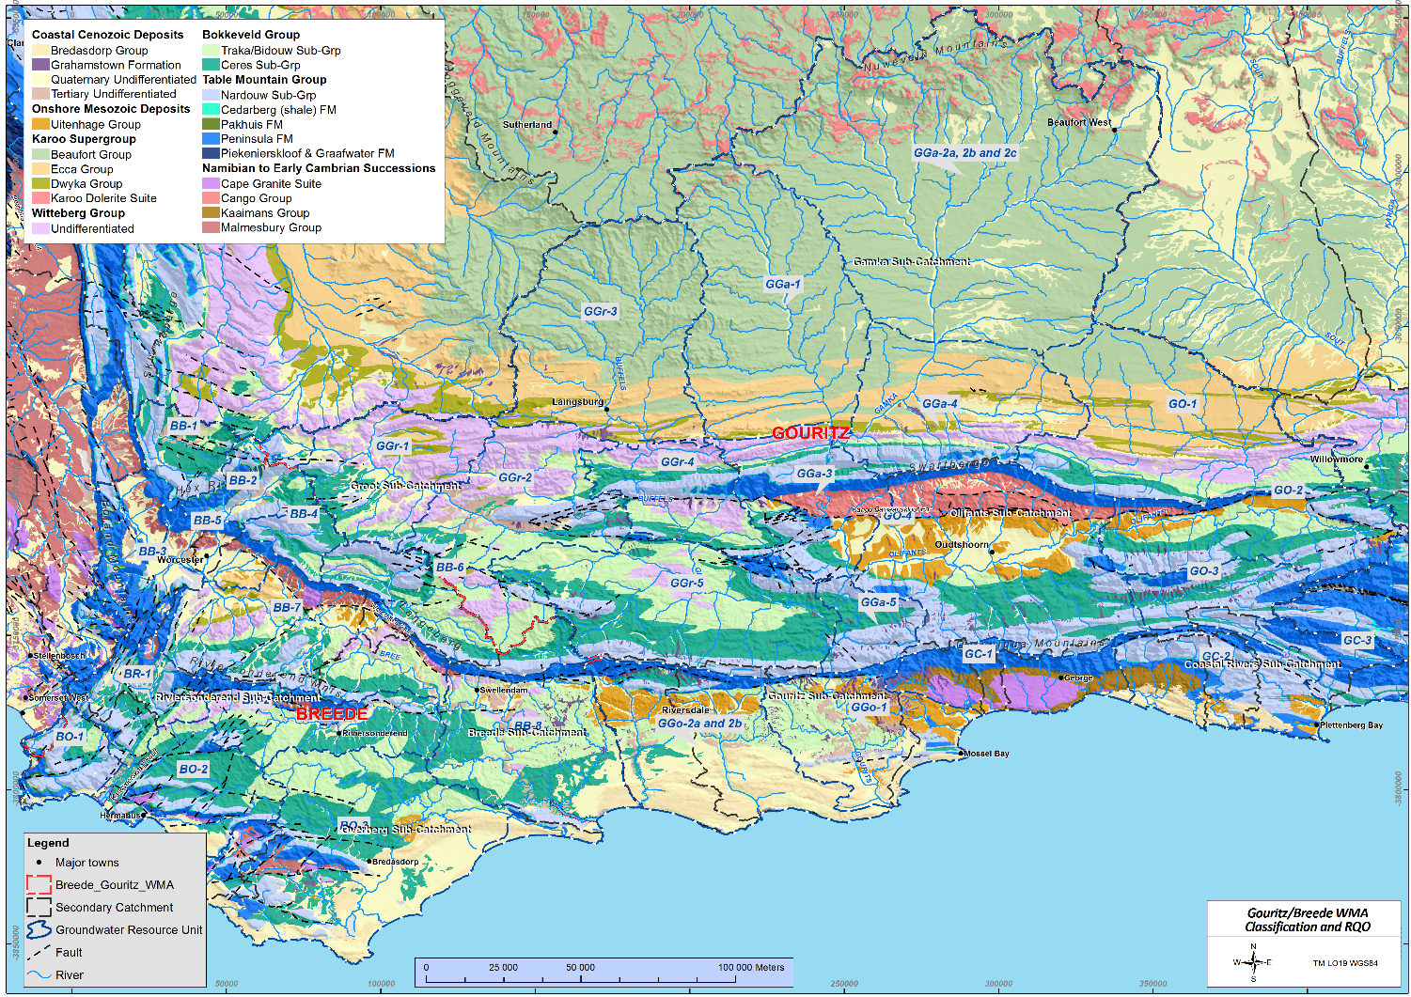
Key aquifers
 | Geology | Aquifer?
Oldest Youngest | Coastal Cenozoic Deposits | Aquifer
 | Karoo Supergroup | Contains aquifers, aquitards and aquicludes
 | Cape Supergroup | Contains aquifers, aquitards and aquicludes
 | “Basement” Malmesbury Shale intruded by granite | Locally an aquifer Regionally an aquitard

Slide 65
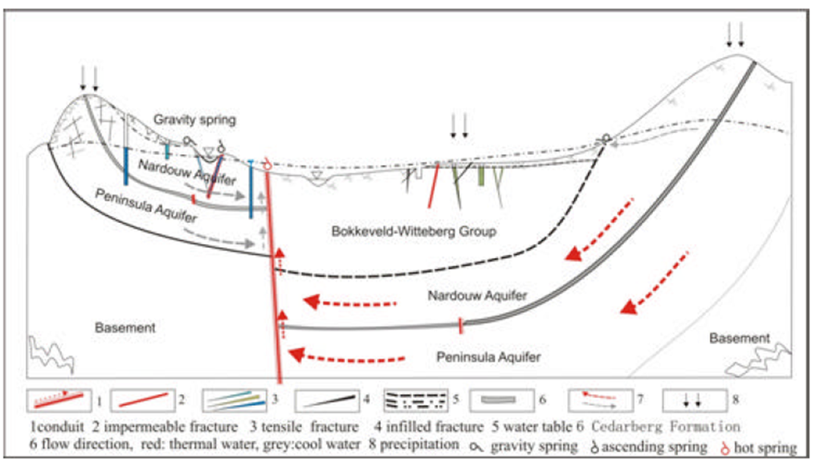
Key aquifers
(adapted from Wu, 2005)
Notes:
The Peninsula Formation often forms the head water of major drainage system (sometimes in the opposite direction of the deep groundwater flow system) and depending on the geological setting can contribute to recharge and groundwater flow on either side of the drainage divide. It’s generally observed that the Skurweberg aquifer contributes more directly to river baseflow both via the river bottom and via springs at the Nardouw – Cedarberg contact, while the Peninsula contributes to river flow mainly as surface run-off.
A water balance based on (surface water) catchment boundaries may lead to erroneous results.
An attempt made to define GRUs that incorporate the major inputs and outputs to the groundwater availability within that GRU area.
For consistency during the delineation process the contact between the Peninsula Formation and the reminder of the TMG and the overlying Cape Supergroup was used in cases where it was deemed necessary (i.e. main recharge/run-off area).
Using standard procedures the groundwater classification can be applied to each resource unit but with scrutiny some links will exist between resource units.
Also applied the classification process to all quaternary catchments within the GRU – but – the water balance type estimates at catchment scale are subject to greater inaccuracy / misrepresentation

Slide 66
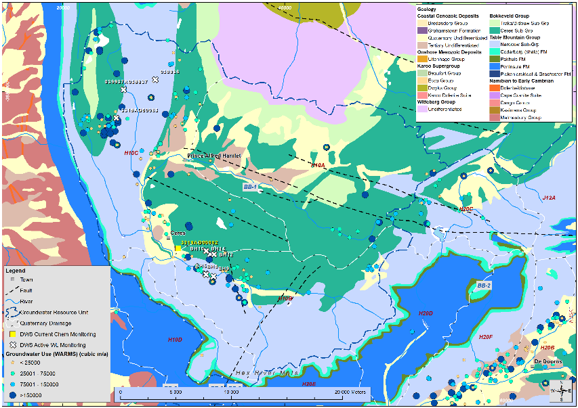
RQOs EXAMPLE: Groundwater Resource Unit BB-1

Slide 67
BB-1
RQOs EXAMPLE: Groundwater Resource Unit BB-1
GRU | Quat(s) | Aquifer | Component | Sub-Component | RQO Description (narrative) | Indicator | Numerical Limit
BB-1 | H10A, H10B, H10C | Bokkeveld Group, Nardouw Group, Cenozoic coastal deposits | Quantity | Abstraction | Groundwater use should be sustainable for all users and the environment | Seasonal abstraction: water level recovers from abstraction impact during wet season, under consideration of climate change and drought cycles. Permanent abstraction: water level decline stabilises under consideration of aquifer response time. | n/a
 |  |  |  | Discharge | The natural gradient between groundwater and surface water should be maintained | Relative water levels between groundwater and suface water (in mamsl) | n/a
 |  |  |  | Discharge | No groundwater abstraction around wetland and river FEPAs in accordance with the implementation manual for FEPAs. | Buffer zones | 250m
 |  |  |  | Low flow in river | Compliance to the low flow requirements in the river, as per surface water RQO requirement | Compliance with the lowflow requirements in the river | See section 3.1
Excludes the buried Peninsula (so not "all' and not "TMG“) given the deep Peninsula may not mimic surface topography, will not be in connection with rivers, and may be drilled into.

Slide 68
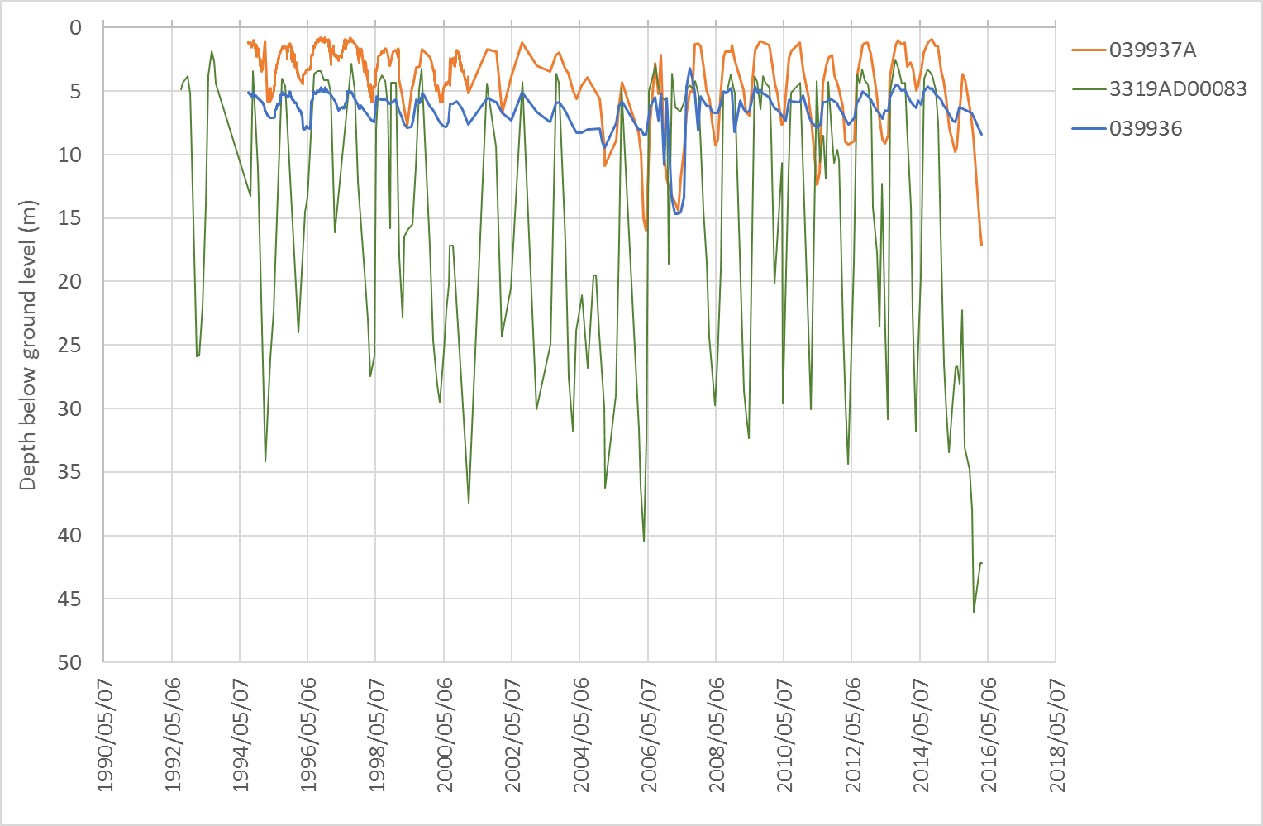
RQOs EXAMPLE: Groundwater Resource Unit BB-1

Slide 69
BB-1
RQOs EXAMPLE: Groundwater Resource Unit BB-1
95% from this geology in this region
90% from this geology in this region
95% from this geology across the region
GRU | Quat(s) | Aquifer | Component | Sub-Component | RQO Description (narrative) | Indicator | Numerical Value
BB-1 | H10A, H10B, H10C | Cenozoic coastal deposits - alluvium | Quality | Nutrients | Groundwater should be fit for domestic use after treatment; and groundwater quality shall not show a deteriorating trend from natural background | NO₃ (as N) | 6.8 mg/l
 |  |  |  | Salts |  | EC | 311 mS/m
 |  | Bokkeveld Group |  | Nutrients |  | NO₃ (as N) | 2.4 mg/l
 |  |  |  | Salts |  | EC | 236 mS/m
 |  | Nardouw Group |  | Nutrients |  | NO₃ (as N) | 4.4 mg/l
 |  |  |  | Salts |  | EC | 119 mS/m
 |  | Bokkeveld Group, Nardouw Group, Cenozoic coastal deposits |  | Pathogens |  | E-coli | 0 counts / 100 ml
 |  |  |  | Pathogens |  | Total Coliform | 10 counts / 100ml

Slide 70
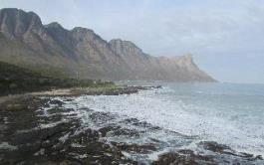
6. General discussion

Slide 71
7. Next Steps & Way Forward

Slide 72
Next steps & Way Forward
Gazetting of Classes & RQOs: Jan 2019

Slide 73
Thank you!
  For more information:
    Register on project specific web-site or email:
      https://www.dwa.gov.za/rdm/Documents.aspx
      BGClassRQO@gmail.com
  For more information contact:
    Project Team: Bea Whittaker
    BGClassRQO@gmail.com
            or Erik van der Berg
            Erik.vanderBerg@aurecongroup.com
    DWS (Pretoria): Lekalake Esther (LekalakeE@dws.gov.za)

Slide 74
Additional slides

